Slide 1
UNIT-4: Unsupervised Learning
Introduction to Clustering
Unsupervised vs Supervised Learning,
Different types of clustering techniques
– Partitioning Methods
– Hierarchical methods
– Density Based Methods
–Grid Based Methods
– Model Based Clustering Methods.
4. K-means clustering,
5. Apriori algorithm and
Association rule.
Hierarchical clustering, K-Medoids,
Density-based methods – DBSCAN.

Slide 2
Differentiate between Classification and Clustering
Sr. No. | Classification | Clustering
01 | Classification is a supervised learning technique where a specific label is provided to the machine to classify new observations. | Clustering is an unsupervised learning technique where grouping is done on similarities basis.
02 | It prefers a training dataset. | It does not prefer a training dataset.
03 | Classification is more complex as compared to clustering. | Clustering is less complex as compared to the classification.
04 | In classification, there are predefined labels assigned to each input instance. | Clustering does not involve any labelling.
05 | it has labels so there is need of training and testing dataset for verifying the model created. | there is no need of training and testing dataset.
06 | For example:- Logistic Regression, Naive Bayes classifier, KNN,SVM, DT, etc. | For example:- k-Means clustering, Fuzzy c-means clustering, Gaussian (EM) clustering algorithm, etc.

Slide 3
Types of Clustering Methods
The clustering methods are broadly divided into Hard clustering (data point belongs to only one group) and Soft Clustering (data points can belong to another group also).
Partitioning Clustering
Hierarchical Clustering
Density-Based Clustering
Model-Based Clustering
Grid-Based Methods

Slide 4
Partitioning Clustering
It is a type of clustering that divides the data into non-hierarchical groups.
It is also known as the centroid-based method.
The most common example of partitioning clustering is the K-Means Clustering algorithm.
In this type, the dataset is divided into a set of k groups, where K is used to define the number of pre-defined groups.
The cluster center is created in such a way that the distance between the data points of one cluster is minimum as compared to another cluster centroid.

Slide 5
What is a Hierarchical Clustering?
Hierarchical clustering is separating data into groups based on some measure of similarity, finding a way to measure how they’re alike and different, and further narrowing down the data.
In this algorithm, we develop the hierarchy of clusters in the form of a tree, and this tree-shaped structure is known as the dendrogram.
Sometimes the results of K-means clustering and hierarchical clustering may look similar, but they both differ depending on how they work. As there is no requirement to predetermine the number of clusters as we did in the K-Means algorithm.

Slide 6
The hierarchical clustering technique has two types:
Agglomerative: Agglomerative is a bottom-up approach, in which the algorithm starts with taking all data points as single clusters and merging them until one cluster is left.
Divisive: Divisive algorithm is the reverse of the agglomerative algorithm as it is a top-down approach.

Slide 7
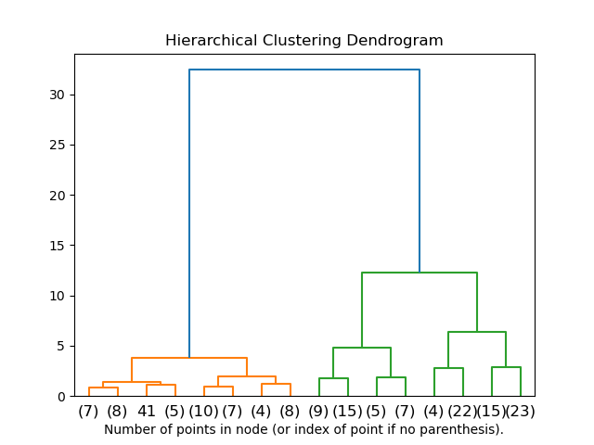

Slide 8
Agglomerative hierarchical algorithms − In agglomerative hierarchical algorithms, each data point is treated as a single cluster and then successively merge or agglomerate (bottom-up approach) the pairs of clusters.
The hierarchy of the clusters is represented as a dendrogram or tree structure.

Slide 9
Steps to Perform Agglomerative Hierarchical Clustering (AHC) is as follows −
Step 1 − Treat each data point as single cluster. Hence, we will be having, say K clusters at start. The number of data points will also be K at start.
Step 2 − In this step, Form a big cluster by joining two closet data points. This will result in total of K-1 clusters.
Step 3 − Now, to form more clusters we need to join two closet clusters. This will result in total of K-2 clusters.
Step 4 − Now, to form one big cluster repeat the above three steps until K would become 0 i.e. no more data points left to join.
Step 5 − At last, after making one single big cluster, dendrograms will be used to divide into multiple clusters depending upon the problem.

Slide 10
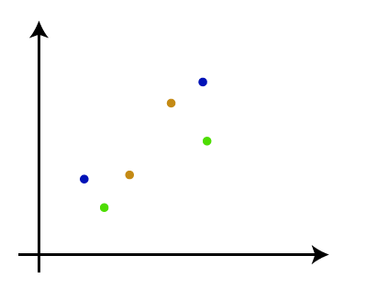
The working of the AHC algorithm can be explained using the below steps:
Step-1: Create each data point as a single cluster.
Let's say there are N data points, so the number of clusters will also be N. In this example N=6

Slide 11
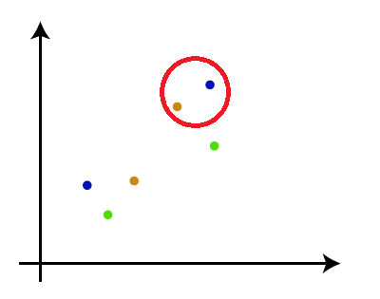
Step-2: Take two closest data points merge them together to form one cluster. So, there will now be N-1 clusters.

Slide 12
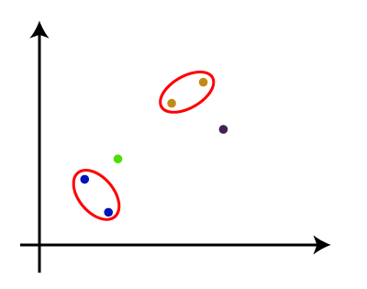
Step-3: Again, take the two closest clusters(Data point) and merge them together to form one cluster. There will be N-2 clusters.

Slide 13
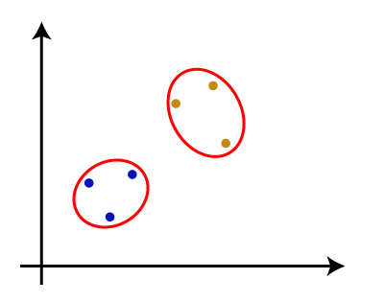
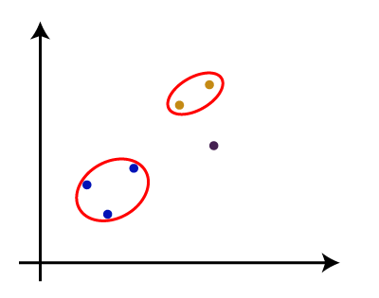
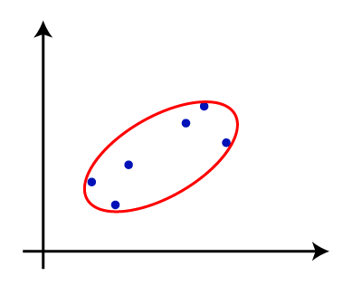
Step-4: Repeat Step 3 until only one cluster is left. So, we will get the following clusters.
Consider the below images:
Step-5: Once all the clusters are combined into one big cluster, develop the dendrogram to divide the clusters as per the problem.

Slide 14
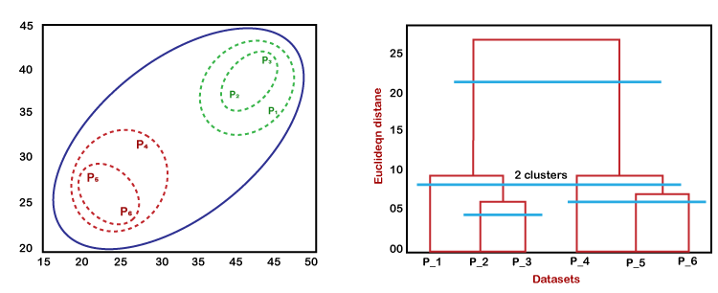
The working of the dendrogram can be explained using the below diagram:
In the above diagram, the left part is showing how clusters are created in agglomerative clustering, and
In the above diagram, the right part is showing the corresponding dendrogram.

Slide 15
In the above diagram, the left part is showing how clusters are created in agglomerative clustering, and the right part is showing the corresponding dendrogram.
As we have discussed above, firstly, the datapoints P2 and P3 combine together and form a cluster, correspondingly a dendrogram is created, which connects P2 and P3 with a rectangular shape. The height is decided according to the Euclidean distance between the data points.
In the next step, P5 and P6 form a cluster, and the corresponding dendrogram is created. It is higher than of previous, as the Euclidean distance between P5 and P6 is a little bit greater than the P2 and P3.
Again, two new dendrograms are created that combine P1, P2, and P3 in one dendrogram, and P4, P5, and P6, in another dendrogram.
At last, the final dendrogram is created that combines all the data points together.

Slide 16
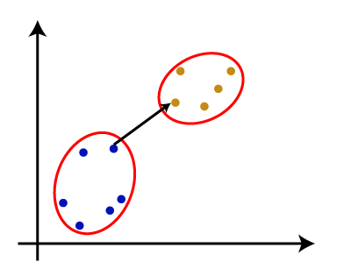
Measure for the distance between two clusters
As we have seen, the closest distance between the two clusters is crucial for the hierarchical clustering. There are various ways to calculate the distance between two clusters, and these ways decide the rule for clustering. These measures are called Linkage methods.
Some of the popular linkage methods are given below:
1. Single Linkage: It is the Shortest Distance between the closest points of the clusters. Consider the below image:

Slide 17
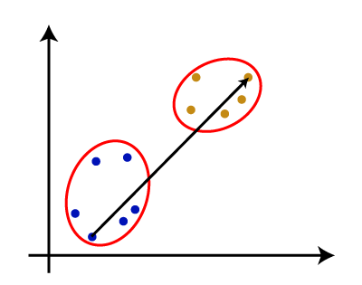
2. Complete Linkage: It is the farthest distance between the two points of two different clusters. It is one of the popular linkage methods as it forms tighter clusters than single-linkage.
3. Average Linkage: It is the linkage method in which the distance between each pair of datasets is added up and then divided by the total number of datasets to calculate the average distance between two clusters. It is also one of the most popular linkage methods.

Slide 18
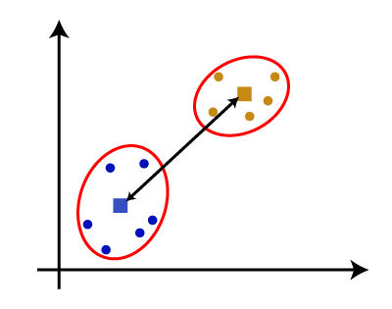
4. Centroid Linkage: It is the linkage method in which the distance between the centroid of the clusters is calculated. Consider the below image:

Slide 19
Dendrogram: Hierarchical Clustering
Dendrogram
Given an input set S
nodes represent subsets of S
Features of the tree:
The root is the whole input set S.
The leaves are the individual elements of S.
The internal nodes are defined as the union of their children.
19

Slide 20
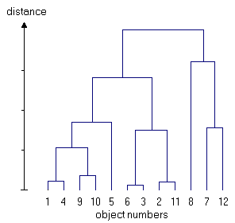
Dendrogram: Hierarchical Clustering
Dendrogram
Each level of the tree represents a partition of the input data into several (nested) clusters or groups.
May be cut at any level: Each connected component forms a cluster.
20

Slide 21
Hierarchical clustering

Slide 22
Hierarchical Agglomerative clustering Matrix
Initially each data point forms a cluster.
Compute the distance matrix between the clusters.
Repeat
Merge the two closest clusters
Update the distance matrix
Until only a single cluster remains.
Different definitions of the distance leads to different algorithms.

Slide 23
Initialization
Each individual point is taken as a cluster
Construct distance/proximity matrix
p1
p2
p3
p4
p5
. . .
p1
p2
p3
p4
p5
.
.
.
Distance/Proximity Matrix

Slide 24
Intermediate State
After some merging steps, we have some clusters
C1
C2
C3
C4
C5
C1
C2
C3
C3
C4
C4
C5
C1
Distance/Proximity Matrix
C2
C5

Slide 25
Intermediate State
Merge the two closest clusters (C2 and C5) and update the distance matrix.
C1
C2
C3
C4
C5
C1
C3
C2
C4
C3
C4
C5
C1
Distance/Proximity Matrix
C2
C5

Slide 26
After Merging
Update the distance matrix
C2 U C5
C1
C3
C4
C3
C1
?
C4
C2 U C5
? ? ? ?
C3
?
C1
C4
?
C2 U C5

Slide 27
Agglomerative Clustering Numerical Example
To solve a numerical example of agglomerative clustering,
let us take the points A (1, 1), B(2, 3), C(3, 5), D(4,5), E(6,6), and F(7,5) and try to cluster them.
To perform clustering, we will first create a distance matrix consisting of the distance between each point in the dataset. The distance matrix looks as follows.

Slide 28
 | A | B | C | D | E | F
A | 0 | 2.236068 | 4.472136 | 5 | 7.071068 | 7.211103
B | 2.236068 | 0 | 2.236068 | 2.828427 | 5 | 5.385165
C | 4.472136 | 2.236068 | 0 | 1 | 3.162278 | 4
D | 5 | 2.828427 | 1 | 0 | 2.236068 | 3
E | 7.071068 | 5 | 3.162278 | 2.236068 | 0 | 1.414214
F | 7.211103 | 5.385165 | 4 | 3 | 1.414214 | 0
Distance matrix for the input dataset
After calculating the distance matrix, we will start clustering the data points using the single linkage approach.

Slide 29
Step 1: First, we will consider each data point as a single cluster. After this, we will start combining the clusters.
Step 2: To combine the individual clusters, we can consider the following points.
Point A is closest to point B.
Point B is at a similar distance to points A and C.
Point C is closest to point D.
Point D is closest to point C.
Point E is closest to F.
Point F is closest to E.
From the above points, we can combine (C, D) and (E, F) as clusters. We will name them CD and EF respectively. As we have ambiguity for points A and B, let us not combine them and treat them as individual clusters.

Slide 30
Step 3: Now, we will calculate the minimum distance between clusters A, B, CD, and EF. You can observe that
Cluster A is closest to B.
Cluster B is closest to A as well as CD.
Cluster EF is closest to CD.
Using the above information let us combine B and CD and name the cluster BCD.
Step 4: After this, The cluster BCD is at the same distance from A and EF. Hence, we will first merge BCD and EF to form BCDEF.

Slide 31
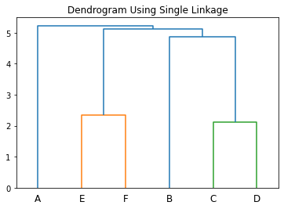
Step 5: Finally, we will merge A and BCDEF to form the cluster ABCDEF.
Using the above steps, we will get the following dendrogram.
In the above example, if we combine (A, B), (C, D), and (E, F) together in step 2 above, we will get clusters AB, CD, and EF.
Now, The minimum distance of CD is the same from AB and EF. Let us merge AB and CD to form ABCD first. Next, we will combine ABCD and EF to obtain the cluster ABCDEF.

Slide 32
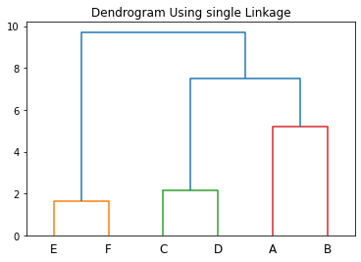
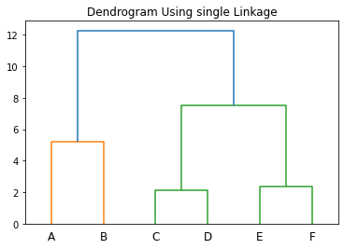
As a result, we will get the following dendrogram.
Instead of combining AB and CD in the previous example, let us first combine CD and EF to form CDEF. Then, we can combine AB with CDEF to form the cluster ABCDEF. As a result, we will get the following dendrogram.

Slide 33
Advantages of Agglomerative Clustering
Agglomerative clustering is simple to implement and easy to interpret. You can implement it very easily in programming languages like python.
It is a bottom-up approach that produces a hierarchical structure of clusters. So, you can choose any level of hierarchy to select a suitable number of clusters. Hence, it allows the clusters to build up from individual elements to the desired level of granularity.
Agglomerative clustering is robust to noise and outliers. As the clusters are derived by combining the nearest clusters into one, the outliers will always stay in a different cluster and will not affect other clusters.
The algorithm does not require any assumptions about the structure of the data or the number of clusters. It can be used with different types of data such as numerical, categorical, and binary. You can take any dataset and define a distance metric between the data points to calculate the distance matrix. After that, you can use the distance matrix to perform clustering as usual.
It can be used for datasets of any size. Agglomerative clustering is a scalable algorithm. You can use it for 10 data points as well as 10 million data points. It is computationally efficient and scalable in both cases.
Agglomerative clustering can be used with a variety of distance or similarity metrics. As the clustering algorithm uses the distance matrix for calculating clusters at each step instead of the actual data points, you can define ant distance or similarity metric to calculate the distance matrix.
Agglomerative clustering is capable of producing clusters with non-convex shapes.

Slide 34
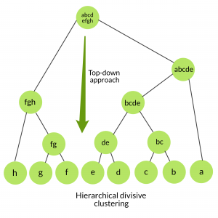
Divisive Clustering:
The divisive clustering algorithm is a top-down clustering approach.
Initially, all the points in the dataset belong to one cluster and split is performed recursively as one moves down the hierarchy.
Steps of Divisive Clustering:
Initially, all points in the dataset belong to one single cluster.
Partition the cluster into two least similar cluster
Proceed recursively to form new clusters until the desired number of clusters is obtained.

Slide 35
K-means clustering with hierarchical clustering
 | K-means clustering | hierarchical clustering
01 | K-Means clustering needed advance knowledge of K i.e. no. of clusters to divide data. | In hierarchical clustering one can stop at any number of clusters, one find appropriate by interpreting the dendrogram.
02 | K-Means algorithm in all its iterations has same number of clusters | Hierarchical clustering is a purely agglomerative approach and goes on to build one giant cluster.
03 | K-Means uses median or mean to compute centroid for representing cluster. | HCA has various linkage method.
04 | K-Means can work with very large datasets. | For very large datasets, HCA can be expensive and slow.
05 | K-Means simply divides data into mutually exclusive subsets (clusters) | HCA arranges it into a tree like format.
06 | K-Means clustering is found to work well when the structure of the clusters is hyper spherical (like circle in 2D, sphere in 3D). | Hierarchical clustering don’t work when the shape of the clusters is hyper spherical.

